Slide 1


Exploring New York City's Diverse Food Cultures for Tourism Purposes
Shabbir Ahmad Presentation
for
Applied Data Science Capstone Project April 29, 2020

Slide 2
Contents
Introduction/Problem Statement
Data Description
Methodology
Data Analysis
Discussion
Conclusion

Slide 3
Introduction / Problem Statement
New York City (NYC) is the largest metropolitan area in the world
Over 65 million tourists visited NYC during 2019
Tourists often find it difficult to find the restaurants and eateries of their choice in those areas.
Tourists are also overwhelmed by the food choices and the decision-making process may be time consuming.
This project explores the boroughs of NYC and locate all the possible food options in different neighbourhoods of the city.
Different types of cuisines are located in the city.

Slide 4
Data Description
Data Requirements
Data related to boroughs (including neighbourhoods) of New York City is required for this project.
Specific data regarding different locations are extracted from Foursquare API.
Libraries like pandas, numpy, matplotlib, folium (for mapping), and pickle are employed for data processing.

Slide 5
Data Description
New York City dataset: This dataset provides the addresses of neighbourhoods of the city. A json file is extracted from this link https://geo.nyu.edu/catalog/nyu_2451_34572
Foursquare API: It is a location data provider and will be used to make API calls to extract data regarding different venues in New York City’s neighbourhoods. To access the API, ‘CLIENT_ID’, ‘CLIENT_SECRET’ and ‘VERSION’ will be defined. This link is used. https://developer.foursquare.com/docs/

Slide 6
Stakeholders/Audience
The audience of this report are mainly local and foreign tourists in New York City who would like to find the eatery of their choice conveniently or explore the diverse food choices available at a particular locality.
Findings of this report can also be used by the tourism department of the city as well as by tour operators to guide the tourists regarding the locations of the diverse food options.

Slide 7
Methodology
Downloading and exploring the dataset
The dataset is downloaded from the aforementioned URL.
The URL returns the .json file containing the dataset in the form of a python dictionary.
The requisite data i.e. the list of five boroughs and the neighbourhoods within these boroughs, is in the features key.

Slide 8
Methodology
Dataframe ‘neighbourhoods’
The dictionary is transformed into a dataframe by looping through the data.
It results into a dataframe with borough, Neighbourhood, Latitude and Longitude details of the city’s neighbourhoods.
The dataframe has a total of 05 boroughs and 306 neighbourhoods.
The latitude and longitude of the New York City is found through ‘Geopy’ library. The latitude is 40.71 while the longitude is -74.01.

Slide 9
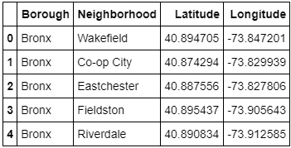
Methodology
First 05 rows of the dataframe

Slide 10
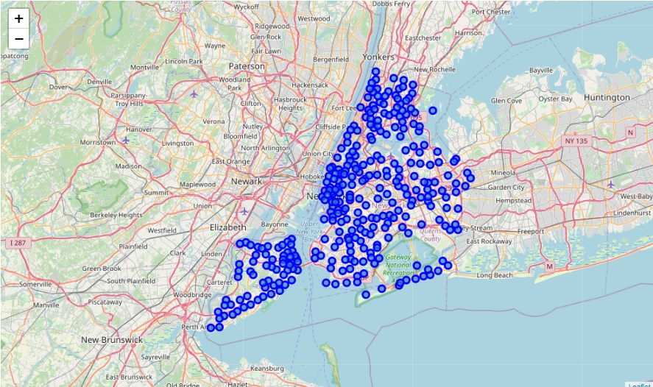
Methodology
The dataframe is further used to generate a map of New York City with neighbourhoods superimposed on top. The map is generated by using the ‘folium’ library.

Slide 11
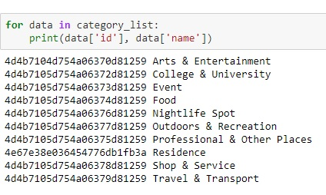
Methodology
Foursquare API
After extracting Foursquare venue category hierarchy, a list of ten categories of venues is generated but we are only interested in ‘Food’

Slide 12
Methodology
Dataframe ‘nyc_venues’
Instead of using GET request for all neighbourhoods to extract information regarding latitude and longitude, a function ‘getNearbyFood’ is created.
It creates an API request URL with radius = 500, LIMIT = 100. Limit is set to 100, so that a maximum of 100 venues are returned in the vicinity.
A new dataframe is created for information regarding all the 306 neighbourhoods.
The dataframe has 13612 venues and 187 unique sub-categories.

Slide 13
Methodology
Data Cleaning
Among the 187 categories of food, general categories like ice cream shops, cafes and bars are also included. We need to eliminate these to make our work easier.
List of general categories is created and then subtracted from all the categories. It leave us only the restaurants and eateries.
After this process, we have 101 unique categories.

Slide 14
Methodology
One hot encoding
It is used to analyse each neighbourhood individually to find out the most common cuisine within 500 meters of its radius.
A new dataframe nyc_onehot is created. ‘Neighbourhood’ column. The size of this dataframe is 6635 data points including all venues for all the neighbourhoods. Now, we can also count the number of venues for each sub-category in every neighbourhood.
The frequency of occurrence of each category is determined by taking mean of all values. The Foursquare API may return many venues since the limit is set to 100

Slide 15


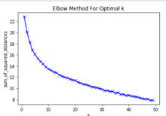
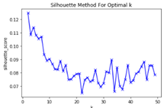
Methodology
Data Processing - Clustering through K-Means
To find the optimal number of clusters, The Elbow Method and The Silhouette Methods are used. The latter provides a better solution.
K = 8

Slide 16
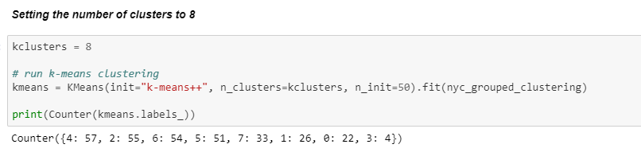
Methodology
Each cluster got the following number of neighbourhoods. Cluster 4 has the highest number (57) while Cluster 3 has the lowest (04).

Slide 17
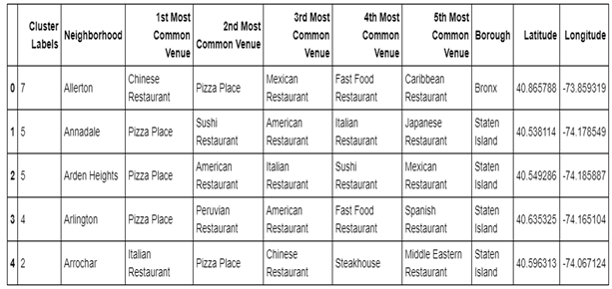
Methodology
Adding Borough, Latitude and Longitude for each neighbourhood to get a complete set of information regarding the venues available in different neighbourhoods.

Slide 18
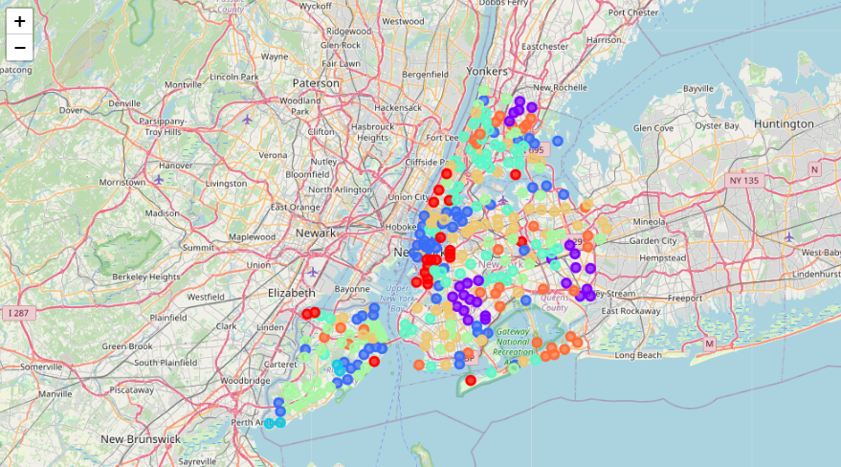
Methodology
Neighbourhoods clusters look like this

Slide 19
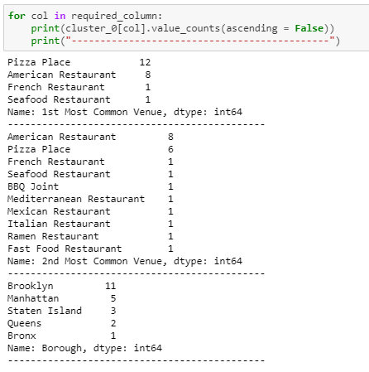
Results
Cluster – 0
Pizza Place is the 1st and American Restaurant is the 2nd most common venue.

Slide 20
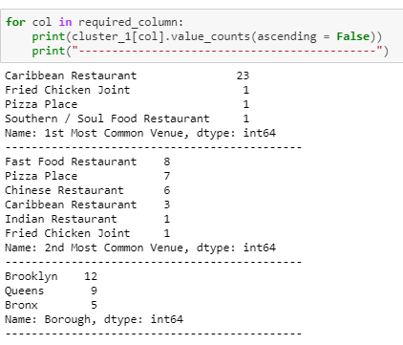
Results
Cluster – 1
Caribbean Restaurant is the 1st and Fast Food Restaurant is the 2nd most common venue.

Slide 21
Results
Cluster – 2
Italian Restaurant is the 1st and Pizza Place is the 2nd most common venue.
Cluster – 3
Italian Restaurant is the 1st and Asian Restaurant is the 2nd most common venue.
Cluster – 4
Pizza Place is the 1st and Fast Food Restaurant is the 2nd most common venue.

Slide 22
Results
Cluster – 5
Pizza Place is the 1st and Italian Restaurant is the 2nd most common venue.
Cluster – 6
Pizza Place is the 1st and Chinese Restaurant is the 2nd most common venue.
Cluster – 7
Chinese Restaurant is the 1st and Pizza Place is the 2nd most common venue.

Slide 23
Discussion
K-mean clustering algorithm is used to segment New York City’s neighbourhoods.
The optimal number of clusters is eight for this project as found out through ‘The Silhouette Method.’
Each of these clusters is analysed through determining the borough count, count of ‘First Most Common Venue’ and ‘Second Most Common Venue.’
Results for the eights clusters are summarized in the table on the next slide

Slide 24
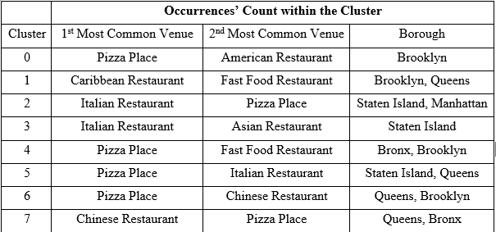
Discussion
Pizza is the most common food in New York City. Since it is considered as go-to food, we can set it aside and regard Italian food as the most common cuisine. Caribbean, Chinese, Asian and American foods are also common in different areas.

Slide 25
Conclusion
Project is aimed at exploring the boroughs of New York City to locate the most common food options in different neighbourhoods.
Data is collected from ‘New York City Dataset’, processed and cleaned through different python libraries. K-mean clustering algorithm is used to segment the data into clusters.
After analysis, we find out that Pizza is the most common food.
Keeping in view the ubiquitous nature of this and other fast foods, it is set aside, and conclusion is drawn on the basis of most common foods next to pizza.
American, Italian, Caribbean, Chinese and Asian cuisines are most common in the city.

